Slide 1
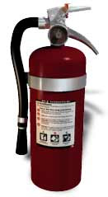
DIRECTORATE OF MAHARASHTRS FIRE SERVICES
FIRE SAFETY EDUCATION
USING A FIRE
EXTINGUISHER
….When to put a Fire
…..When to Exit
……How to use a Fire Extinguisher
…How to use a Fire Extinguisher
Click button for next slide

Slide 2
To Navigate From
Slide to Slide
Use the Buttons
BACK
FORWARD

Slide 3
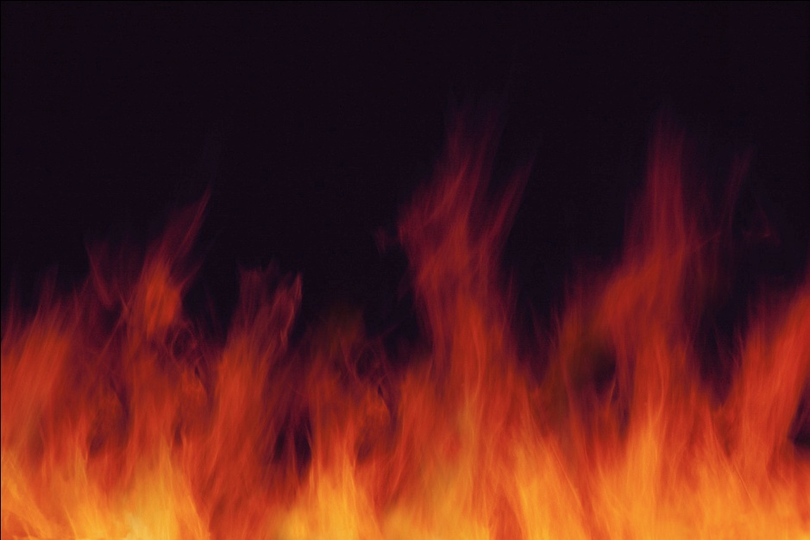
WHAT SHOULD YOU DO
IF YOU DISCOVER
A FIRE?

Slide 4
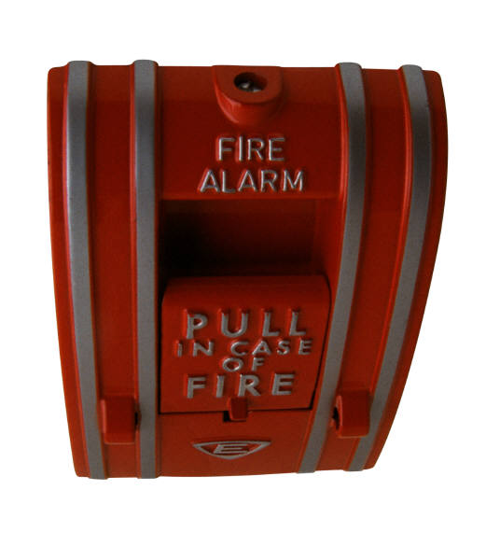
STEP ONE
Pull the nearest
Fire Alarm
OR
Tell a co-worker to pull it!

Slide 5
STEP TWO
Make A Decision
Should I the Building?
Should I use a Fire
Extinguisher?
OR

Slide 6
HOW DO I KNOW
WHICH ONE?

Slide 7
You MUST Exit the building when:
  You have been told by your management that when you hear the fire alarm, you are required to exit.
  The exception is when you have been told you are allowed to do something other than evacuate.

Slide 8
If you have been told to Exit, you MUST EXIT the building EVEN IF:
  There are fire extinguishers hanging on the walls or accessible to you.
  The exception is when you have been specifically trained and are expected to use a fire extinguisher.

Slide 9
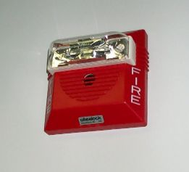
IF YOU HEAR A FIRE ALARM
Immediately evacuate the building.
Do not try to put out the fire with an extinguisher, unless you have been trained and are expected to use an extinguisher.
Wait for the “all clear” signal before you re-enter the building.

Slide 10
You may use a fire extinguisher ONLY IF:
You have been trained on WHEN and HOW to use a fire extinguisher and you receive annual re-training.

Slide 11
You may use a fire extinguisher ONLY when a fire is first starting and is very small like:
In a waste basket
In a microwave oven
In a toaster
and hasn’t spread!

Slide 12
Fire Extinguisher Tips
Most extinguishers only last about 10 – 18 seconds.
Don’t let the fire, heat, or smoke come between you and your way out!
Use the “PASS” system.
Use the right kind of extinguisher.

Slide 13
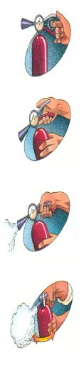
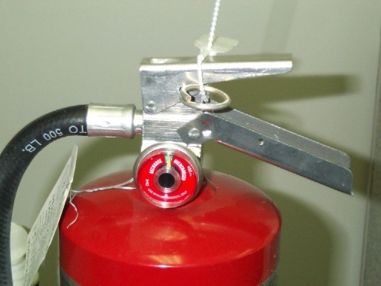
Use the “PASS” system
Pull the pin
Aim at the base of
the fire from about 8 feet away
Squeeze the handle
Sweep from side to side at the base of the fire until it is out

Slide 14
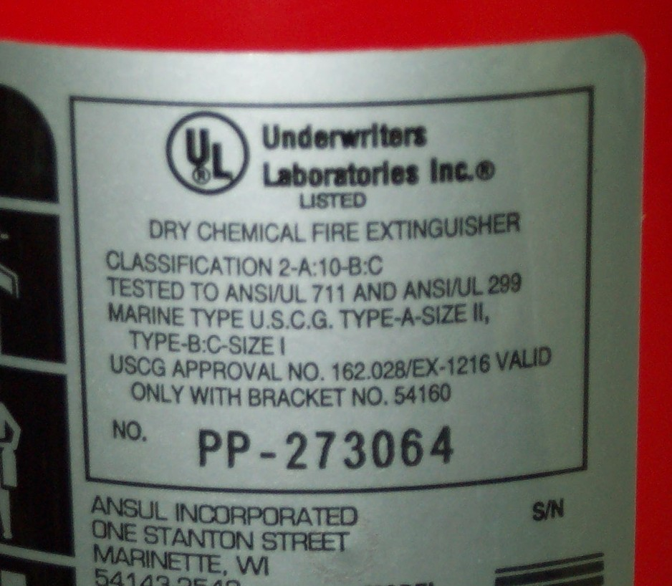
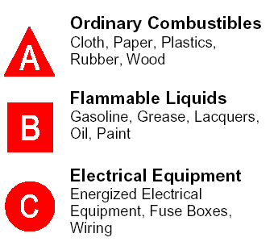
Use The Right Kind Of Extinguisher

Slide 15

Now What?
If the fire goes out:
  Stand back, it can flare up!
  Then, Evacuate!
If the fire doesn’t go out:
  Evacuate!

Slide 16
Quiz
Now let’s answer some questions to see how well you remember the important points about:
… When to put out a Fire
…When to Exit
…How to use a Fire Extinguisher

Slide 17
WHEN CAN YOU USE A FIRE EXTINGUISHER?
Quiz
Choose the best answer:
If you see one within 10 feet of the fire.
If the fire hasn’t left the room.
If the fire is small and hasn’t spread.
If you have someone with you.

Slide 18
Sorry, the correct answer is:
Quiz
Only when a fire is first starting and is very small like:
  In a waste basket
  In a microwave oven
  In a toaster
and hasn’t spread.

Slide 19
That’s right!
Quiz
You can use a fire extinguisher -
Only when a fire is first starting and is very small like:
  In a waste basket
  In a microwave oven
  In a toaster
and hasn’t spread.

Slide 20
A fire extinguisher lasts about?
Quiz
8 to 10 seconds.
10 to 18 seconds.
18 to 30 seconds.
30 to 60 seconds.
Choose the best answer:

Slide 21
Sorry, the correct answer is:
Quiz
Most extinguishers only last about
10 – 18 seconds.

Slide 22
That’s right!
Quiz
Most extinguishers only last about 10 – 18 seconds.

Slide 23
What should you do if you hear a fire alarm?
Quiz
Choose the best answer:
Evacuate immediately.
Find your coat and keys.
Get a co-worker to help put out the fire.
Shut down your computer and evacuate.

Slide 24
Sorry, the correct answer is:
Quiz
Immediately EVACUATE the building.
Do not waste time looking for your coat, keys or shutting down your computer.
Walk out of the building to the appointed meeting place.
Wait for the “all clear” signal before you re-enter the building.

Slide 25
That’s right!
Quiz
Immediately EVACUATE the building.
Do not waste time looking for your coat, keys or being concerned about your workspace.
Walk out of the building to the appointed meeting place.
Wait for the “all clear” signal before you re-enter the building.

Slide 26
The “PASS” system means ?
Quiz
Point Aim Shoot Suds.
Prepare Aim Sweep Shoot.
Point Arm Stand Squeeze
Pull Aim Squeeze Sweep
Choose the best answer:

Slide 27
Sorry, the correct answer is:
Quiz
Pull the pin
Aim at the base of the fire from about 8 feet away
Squeeze the handle
Sweep from side to side at the base of the fire until it is out

Slide 28
That’s right!
Quiz
Pull the pin
Aim at the base of the fire from about 8 feet away
Squeeze the handle
Sweep from side to side at the base of the fire until it is out

Slide 29
Whether you succeed or not in putting out the fire you must ?
Quiz
Return the extinguisher to its mount
Tell your supervisor
Evacuate
Sound the all clear
Choose the best answer:

Slide 30
Sorry, the correct answer is:
Quiz
Evacuate!
  If the fire goes out:
    Stand back, it can flare up!
    Evacuate! (Remember you set off the alarm or asked a coworker to do it before you went for the extinguisher.)
  If the fire doesn’t go out:
    Evacuate!

Slide 31
That’s right!
Quiz
Evacuate!
  If the fire goes out:
    Stand back, it can flare up!
    Evacuate! (Remember you set off the alarm or asked a coworker to do it before you went for the extinguisher.)
  If the fire doesn’t go out:
    Evacuate!

Slide 32
Thank you for taking the time to learn about safety and health and how to prevent future injuries and illnesses.

